Slide 1

“Chat Application”
Task - 2

Slide 2

Todo Planner
A chat application is a software platform that enables users to communicate in real-time via text, voice, or video. It allows individuals or groups to exchange messages, media, and other information. Popular examples include WhatsApp, Facebook Messenger, and Slack
▪
LMS Username
Name
Batch
EBF115B500AB040882341A72B5819654
k.Yuvraj
CA9
600445987D72D9EB4B043116A0B441B1
CA9
B.Veeresh
F7EA8E34DB90511B42F456C5A4110D1B
Dilli G
CA9
EBF115B500AB040882341A72B5819654
CA9
B.Monish

Slide 3

Task -2
Create UI and implement various components using react
●
●
●
Split design into components and Higher order Components
Define structure of the components
Set the basic ui components with dummy data
Integrate the APIs to frontend to ensure the dynamic feature of website
●
●
●
●
●
Point base api to the severs base url
Design api calls for each element
Handle errors in the output
Render output of apis to different low level components
Secure content of post affix
Evaluation Metric:
● 100% Completion of the above tasks
Learning Outcome
▪
▪
▪
▪
Developing complicated UI using react components
Using props drilling and context to pass variables
Getting familiar with different type of api calls
Handling different input data

Slide 4

Step-Wise Description
1.Define Requirements
2.Choose Technology Stack
3.Set up the develop Environment
4.Creat the back end
5.Build the front end
6.Implement the real time Communication
7.Handle Data Storage
8.Test the application
9.Deploy the Application
10.Moniter and Maintain
Summary of your task
Define the requirements and functionalities.Choose appropriate technologies for front-end, back-end, and database.Set up the development environment and tools.Create the back-end with Node.js, Express.js, and MongoDB, incorporating user authentication with Passport.js and JWT.Build the front-end using React or Angular, including components for user authentication and messaging.Implement real-time communication using WebSockets or Socket.IO.Configure the database for storing user information and messages, with CRUD operations.Conduct thorough testing to ensure proper functionality.Deploy the application to a hosting service like Heroku, AWS, or Firebase.Monitor and maintain the application regularly for updates and security.

Slide 5
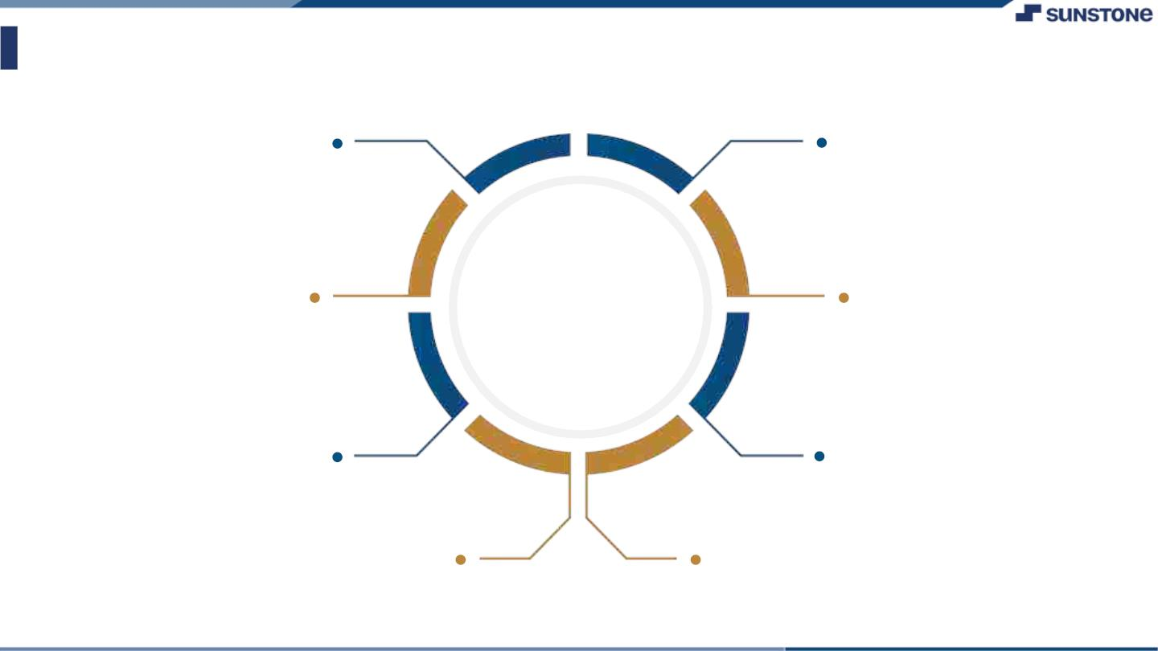
AssessmentꢀParameter
Setup Project for
To-Do-Planner project
Setup basic structure of text-
editor project
Create a main component with the
outer structure of To-Do-Planner
Check-List
Create main component with
all feature buttons
Create a button component
with on click handler
Create a json object to store
data for text editor
Create a assignment function
to assign a task and see the tasks
Push both code to github

Slide 6

Submission Github
https://github.com/rajuroyal-web/online-chat-application-

Slide 7


